Slide 1
2019 Music Listening Championship COLLEGE BOWL ROUND

Slide 2
Practice Question
What is the Naxos Password?

Slide 3
Practice Answer
MLC2019

Slide 4
COLLEGE BOWL ROUND
Know Your “ism”s
Quotable Quotes
Rhyme Time
Rapping with Ravel
Visual
Arts
100
100
100
100
100
200
200
200
200
200
300
300
300
300
300
400
400
400
400
400
500
500
500
500
500
Rhyme Time
Example
Tie-breaker

Slide 5
Name That “ism” - $100 Question
This genre of music emphasizes repeated motives and consonant harmonies.

Slide 6
Name That “ism” - $100 Answer
Minimalism

Slide 7
Name That “ism” - $200 Question
A term used to describe a return to the emotional expressionism associated with 19th-century music.

Slide 8
Name That “ism” - $200 Answer
Neo-romanticism

Slide 9
Name That “ism” - $300 Question
Mary Ellen Childs frequently writes in this style of music.

Slide 10
Name That “ism” - $300 Answer
Postminimalism

Slide 11
Name That “ism” - $400 Question
A style of music that may leave you wondering “But is it art?”

Slide 12
Name That “ism” - $400 Answer
Postmodernism

Slide 13
Name That “ism” - $500 Question
A philosophical movement marked by a renewed interest in Ancient Greece and Rome.

Slide 14
Name That “ism” - $500 Answer
Humanism

Slide 15
Quotable Quotes - $100 Question
Who said it???
“There’s something very human about [the organ] because it can only make a sound with air. It needs to breathe. With each note you hear the breath, the exhale.”

Slide 16
Quotable Quotes - $100 Answer
Hans Zimmer

Slide 17
Quotable Quotes - $200 Question
Who said it???
“I did my work slowly, drop by drop. I tore it out of me by pieces.”

Slide 18
Quotable Quotes - $200 Answer
Maurice Ravel

Slide 19
Quotable Quotes - $300 Question
Who wrote it???
“[…] Are you sure
That we are awake? It seems to me
That yet we sleep, we dream.”

Slide 20
Quotable Quotes - $300 Answer
William Shakespeare

Slide 21
Quotable Quotes - $400 Question
Who wrote it???
“Here, now, the waves murmur
And the leaves and the poplars tremble in the morning breeze,”

Slide 22
Quotable Quotes - $400 Answer
Torquato Tasso

Slide 23
Quotable Quotes - $500 Question
Who wrote it???
“The public use of one’s reason must be free at all times, and this alone can bring enlightenment to mankind.”

Slide 24
Quotable Quotes - $500 Answer
Immanuel Kant

Slide 25
Rhyme Time - $100 Question
Treble Kitchen Cook

Slide 26
Rhyme Time - $100 Answer
Clef Chef

Slide 27
Rhyme Time - $200 Question
Fishy Medieval Liturgical Service

Slide 28
Rhyme Time - $200 Answer
Bass Mass

Slide 29
Rhyme Time - $300 Question
Leafy Green Sequence of Pitches

Slide 30
Rhyme Time - $300 Answer
Kale Scale

Slide 31
Rhyme Time - $400 Question
Romantic Composer Rodent

Slide 32
Rhyme Time - $400 Answer
Strauss Mouse

Slide 33
Rhyme Time - $500 Question
Boiling Film Composer

Slide 34
Rhyme Time - $500 Answer
Simmer Zimmer

Slide 35
Rapping with Ravel - $100 Question
Maurice Ravel, what a brain he has,
came up with this piece when he first heard jazz.
It almost didn’t happen because of tension,
continued only after diplomatic intervention.

Slide 36
Rapping with Ravel - $100 Answer
Piano Concerto in G Major

Slide 37
Rapping with Ravel - $200 Question
It was a popular work, an auditorium full-seater,
this Spanish song performed in triple meter.
But conductor Toscanini was loose with the tempo
which made Ravel say “oh heck no.”

Slide 38
Rapping with Ravel - $200 Answer
Bolero

Slide 39
Rapping with Ravel - $300 Question
When Ravel broke onto the music scene –
the critic Lalo? Well, he was pretty mean.
He claimed Ravel was nothing but a poser
who imitated this esteemed French composer.

Slide 40
Rapping with Ravel - $300 Answer
Claude Debussy

Slide 41
Rapping with Ravel - $400 Question
It was tragedy for Little Tom
when he discovered his breadcrumbs were gone.
The birds that caused Little Tom’s frustration
can now be heard in this Ravel orchestration.

Slide 42
Rapping with Ravel - $400 Answer
Ma mere l’Oye
(Mother Goose Suite)

Slide 43
Rapping with Ravel - $500 Question
It was 1914, and things looked grim,
World War I was waging, hope was slim.
So Ravel wrote a piece to honor his pals,
it was premiered by this talented pianist gal.

Slide 44
Rapping with Ravel - $500 Answer
Marguerite Long

Slide 45
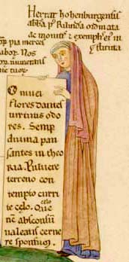
Visual Arts - $100 Question
Identify the composer depicted here.

Slide 46
Visual Arts - $100 Answer
Herrad (of Landsberg)

Slide 47
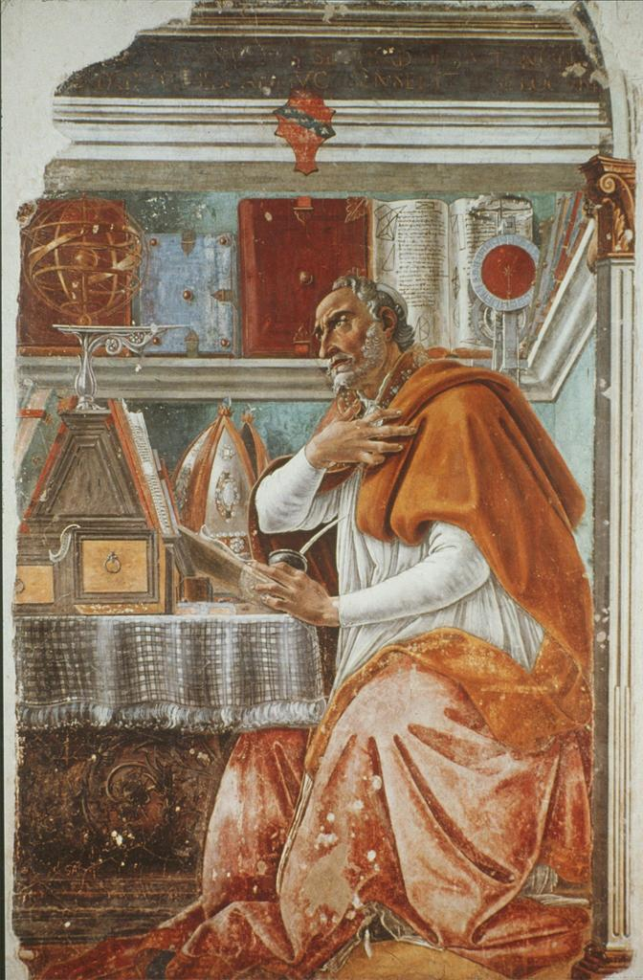
Visual Arts - $200 Question
This work was painted during what musical era?

Slide 48
Visual Arts - $200 Answer
Renaissance Era

Slide 49
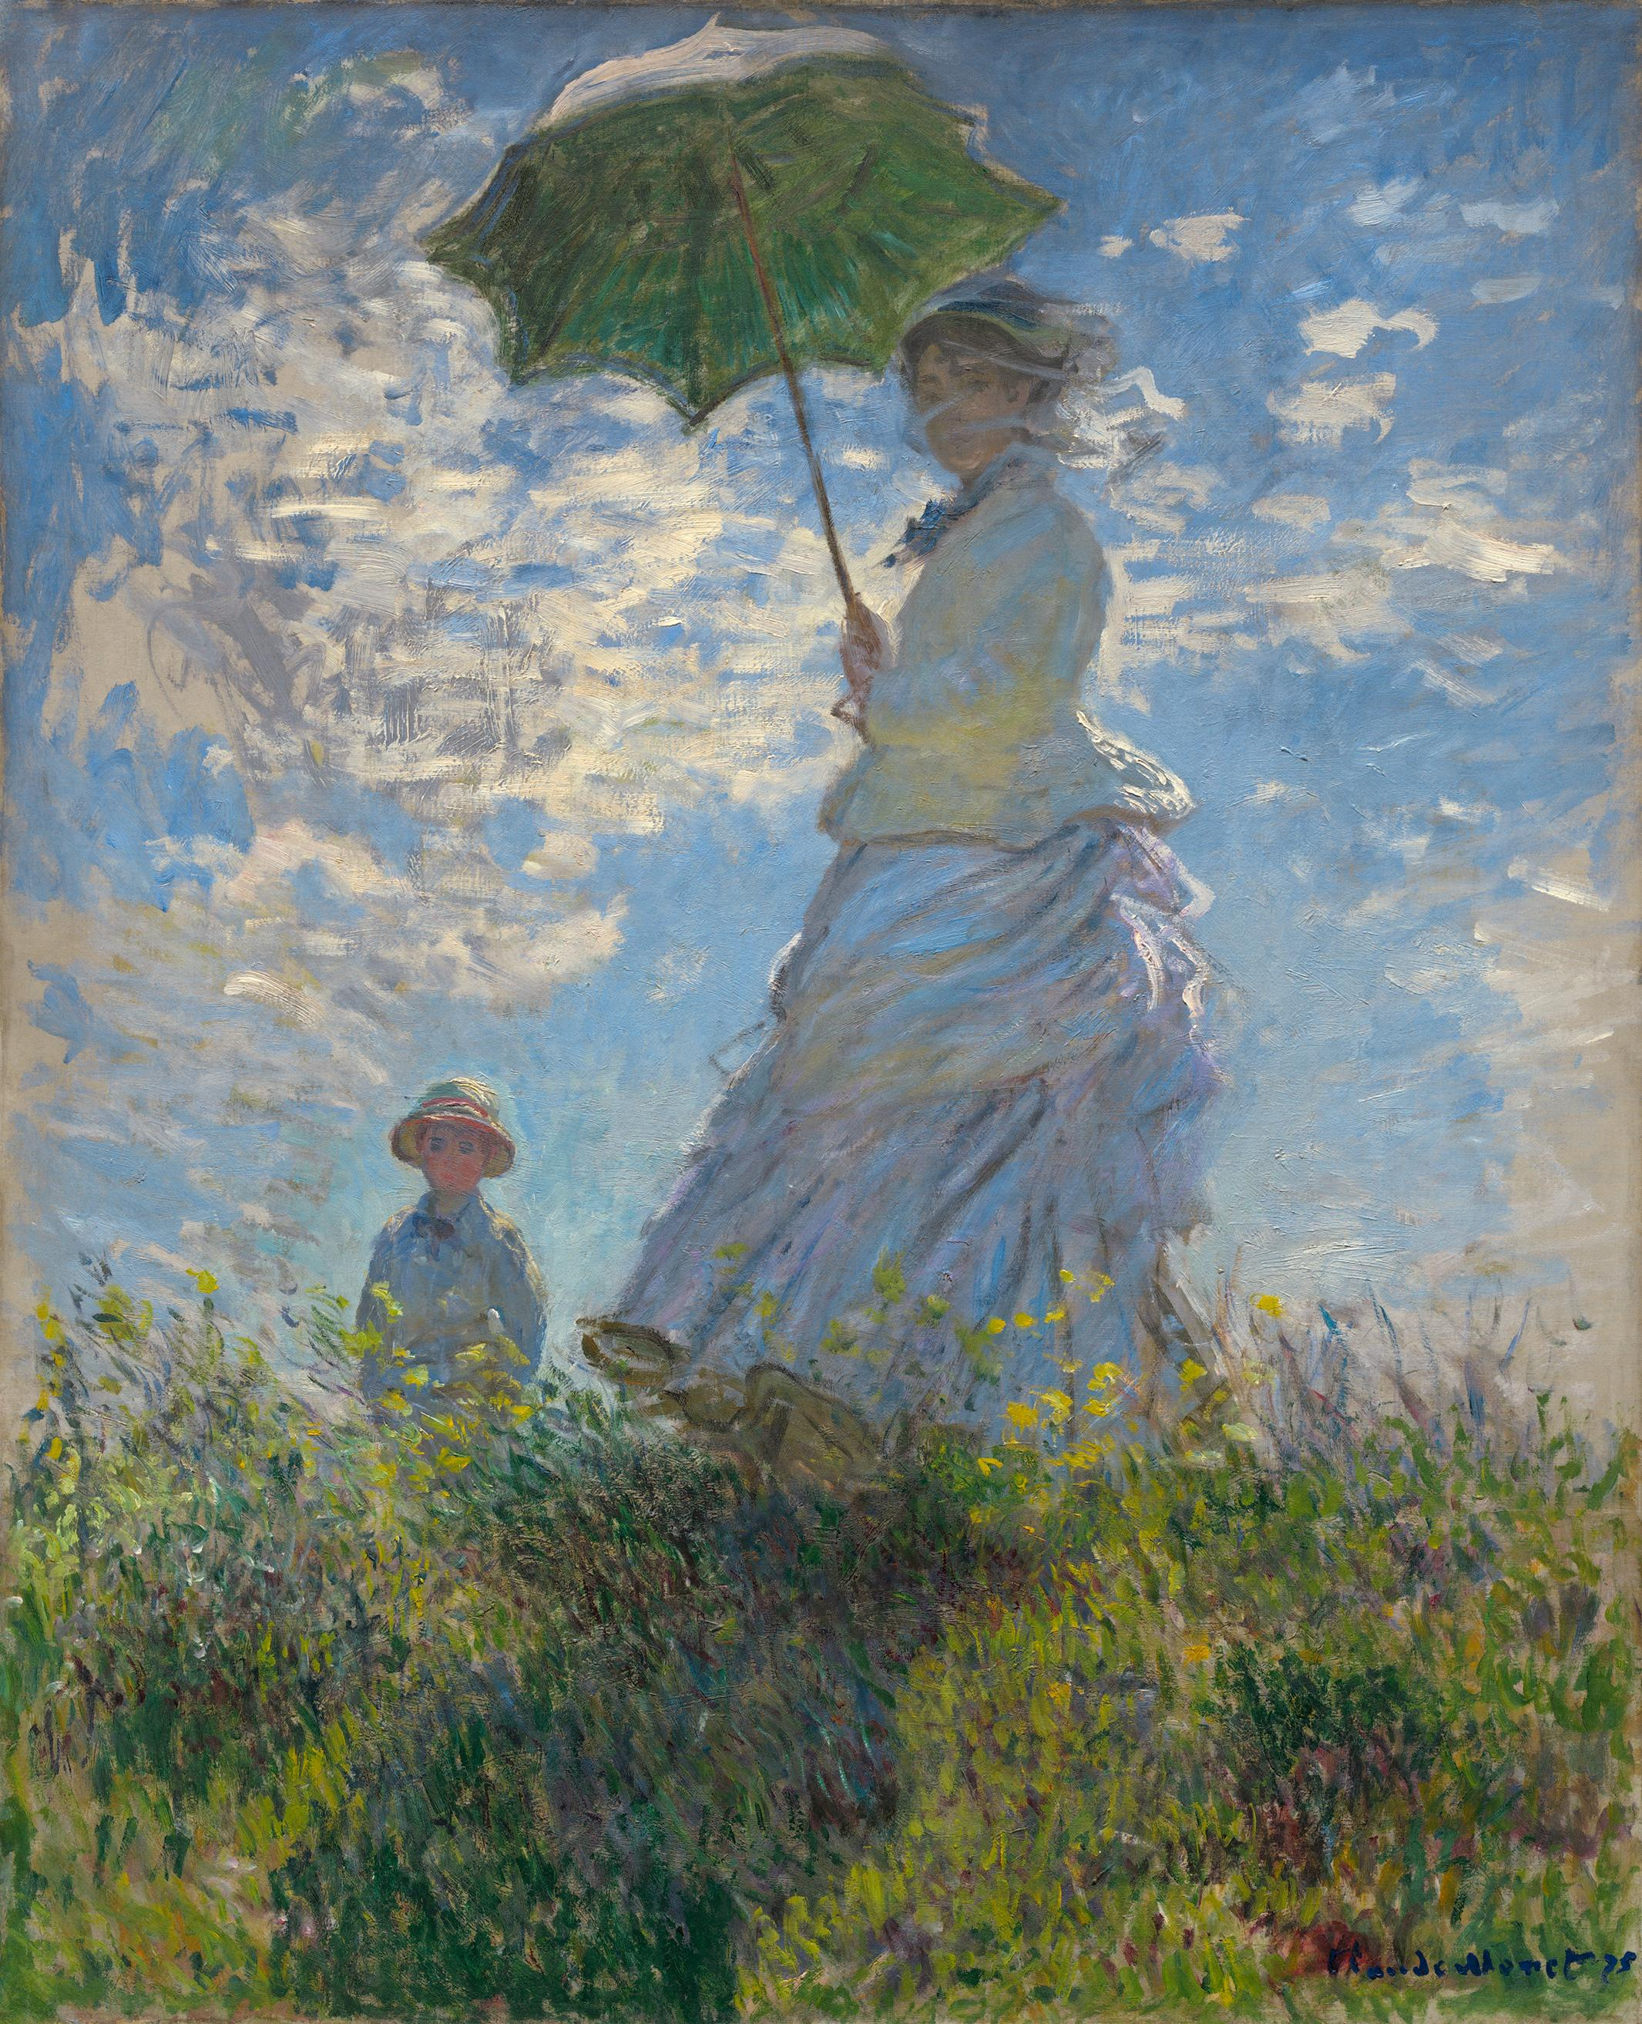
Visual Arts - $300 Question
Name the style of painting.

Slide 50
Visual Arts - $300 Answer
Impressionism

Slide 51
Visual Arts - $400 Question
What is the title of this work?

Slide 52
Visual Arts - $400 Answer
“White Painting"

Slide 53
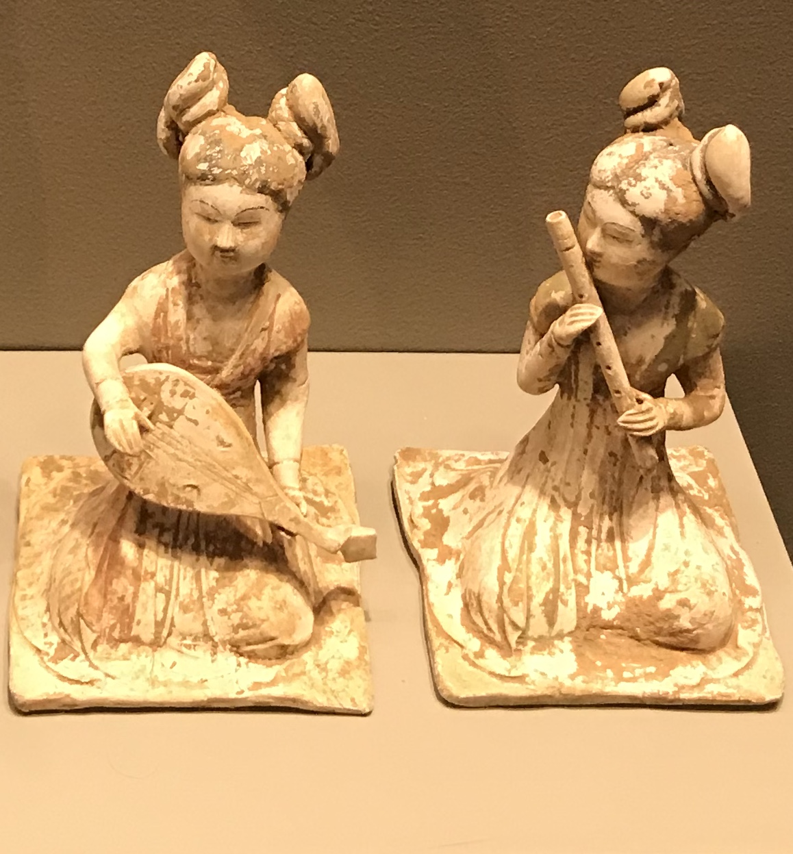
Visual Arts - $500 Question
What two methods of playing are depicted in this sculpture?

Slide 54
Visual Arts - $500 Answer
Blowing and Plucking

Slide 55
Tie-Breaker
His Treatise on Harmony was one of the first real efforts to explain how tonal music functions.

Slide 56
Tie-Breaker Answer
(Jean-Phillippe)
Rameau

Slide 57
Rhyme Time EXAMPLE
Obnoxious Athlete
Johann Sebastian

Slide 58
Rhyme Time EXAMPLE
Jock Bach

